Slide 1
TLS and TLS MITM
CS 361S
Spring 2020
Seth James Nielson

Slide 2
Secure Communications
(Entity) Authentication – Assurance of party identity
Confidentiality – Unreadability of data by unauthorized parties
(Data Origin) Authentication – Unwritability of data by unauthorized parties

Slide 3
Alternate Terms
CIA – Confidentiality, Integrity, Availability
Integrity is more-or-less equivalent to Data Origin Authentication
Availability means data cannot be denied to authorized parties
Data origin authentication means that data came from an authorized party
Data origin authentication implies integrity

Slide 4
Policy and Mechanism are Different!
Policy | Mechanism
Confidentiality | Encryption
Entity Authenticaiton | Public Key Infrastructure (Certificates)
Data Origin Authentication | Message Authentication Code

Slide 5
Symmetric Key Cryptography
One key both encrypts and decrypts data
Typically fast and useful for bulk encryption
Can provide confidentiality, but generally not integrity

Slide 6
Asymmetric Cryptography
Algorithms use TWO keys: one public, one private
Different algorithms support different operations
Key agreement
Signatures
Encryption
Many algorithms do not support encryption
Encryption, when available, is slow and for short messages

Slide 7
RSA
RSA public-key cryptography DOES encrypt
Public key crypto is often explained using RSA
This can be helpful because RSA is very easy to understand
But remember, other algorithms work differently!

Slide 8
RSA Encryption
RSA provides encryption of short messages
Anyone can encrypt using the public key
But only the owner of the private key can decrypt
Moreover, the encrypting party knows ONLY the owner can decrypt
This provides a secure, authenticated dropbox

Slide 9


RSA Encrypt Visualization
Bob, here’s my public key, K
{some secret}K
Decrypt with K⁻¹

Slide 10
What can RSA Encrypt?
Messages must be smaller than key size (e.g., 2048)
Hundreds of times slower than symmetric key algorithms
So what good is it?
KEY TRANSPORT!

Slide 11
RSA Key Transport
Bob, here’s my public key, K
{session key sk}K
Decrypt with K⁻¹
{Message 1}sk
{Message 2}sk

Slide 12
RSA Signatures
RSA signatures ALSO use encryption, but in the other direction!
The private key owner encrypts with the private key
Anyone can decrypt with the public key
But it must have been encrypted by the private key owner
This provides entity authentication, not confidentiality.

Slide 13
RSA Signatures
Alice publishes her public key K
Alice wants to PROVE that she is the author of message M
Alice produces h(M), the hash of M
Alice produces {h(M)}K⁻¹, the RSA encryption of h(M)
Alice transmits M, and {h(M)}K⁻¹ to Bob.
Bob decrypts h(M) with K
Bob compares h(M) with h’(M), the recomputed hash of M

Slide 14
RSA Signature
Bob, here’s my public key, K
M, {h(M)}K⁻¹
Decrypt h(M) with K
h(M) ?= h’(M)

Slide 15
Reminder
Most Public Key algorithms do NOT work like RSA does
DSA, ECDSA, for example, have signatures, but do not use encryption!
Diffie Hellman (DH), only does key exchange

Slide 16
Key Exchange
Key agreement is where parties create a session key between them
RSA provides Key Transport, as already described
Key Exchange uses public key computations to COMPUTE a shared key

Slide 17
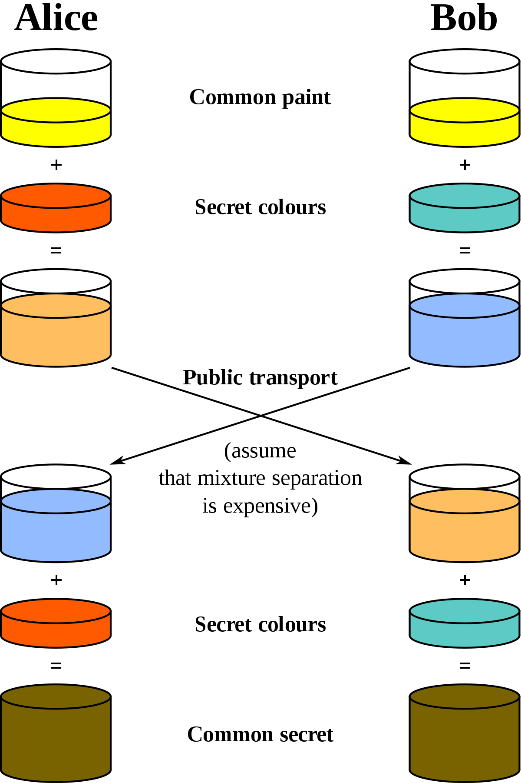
Diffie Hellman Visualization

Slide 18
Forward Secrecy
Forward secrecy = a lost private key only compromises ONE session
Requires a unique public/private key EACH SESSION
RSA keys are slow to generate; keys must be used long term
DH keys are fast to generate; “ephemeral” keys can be used
DHE = Diffie Hellman Ephemeral, provides forward secrecy

Slide 19
The Problem of Trust
How do you know that Alice’s key is Alice’s?
What if Malfoy transmitted HIS key and CLAIMED it was Alice’s?
X509 Certificates bind identity information to a key; this helps
But it’s not enough. Malfoy can generate a fake cert
PKI, Public Key Infrastructure, binds all keys to already trusted keys

Slide 20
DHE + RSA
DH can quickly generate a public key, but how to trust it?
In TLS, the DH ephemeral public key is SIGNED by RSA key from cert
So, there are actually TWO sets of public/private keys
DH ephemeral keys for key agreement
RSA key for signing the DH ephemeral key

Slide 21
Data Origin Authentication
After entity authentication, ensure data received is from that party
Ensure that data is unaltered
Can use something like MAC – Message Authentication Code

Slide 22
HMAC
Hash Message Authentication Code
Details are outside this lecture
Basic concept:
Hash + key
E.g., h(key + data)

Slide 23
TLS 1.2 Handshake
Goal
Agree on a cipher suite for encryption, authentication, etc.
Goal
Identify the server (and optionally the client)
Goal
Create session keys for bi-directional communication

Slide 24
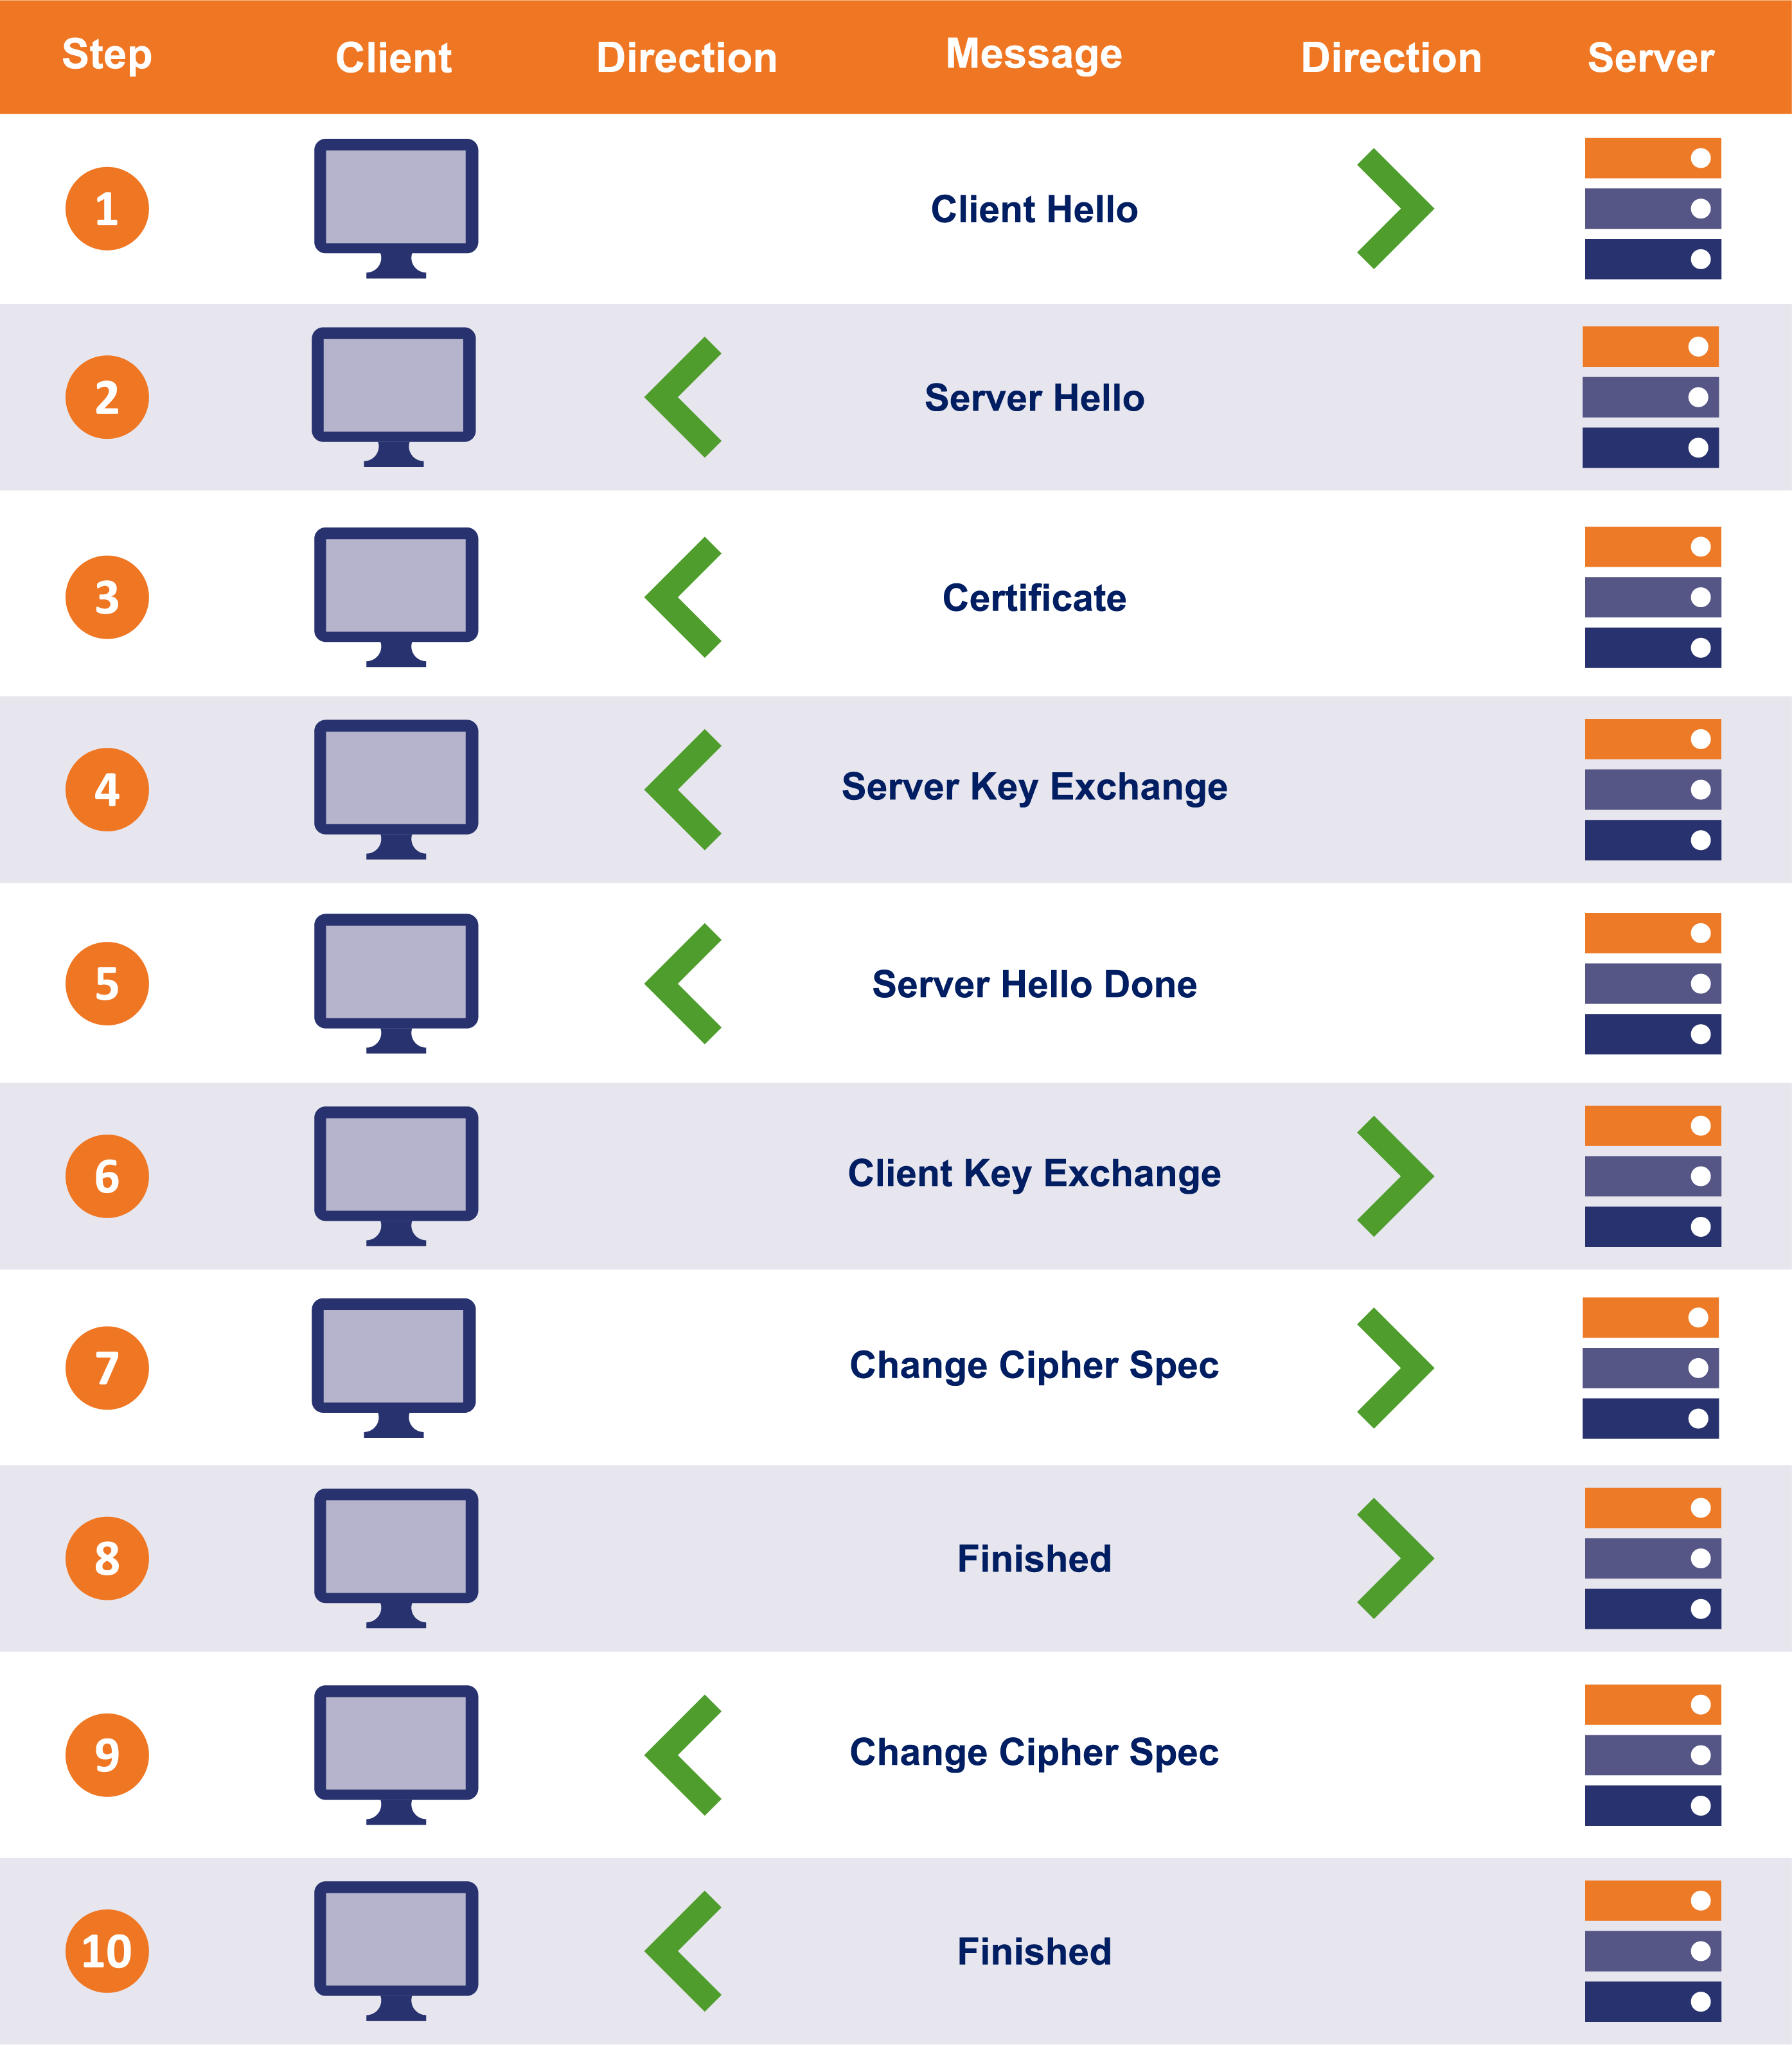
Handshake Visualization

Slide 25
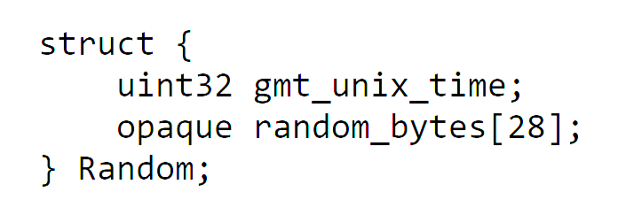
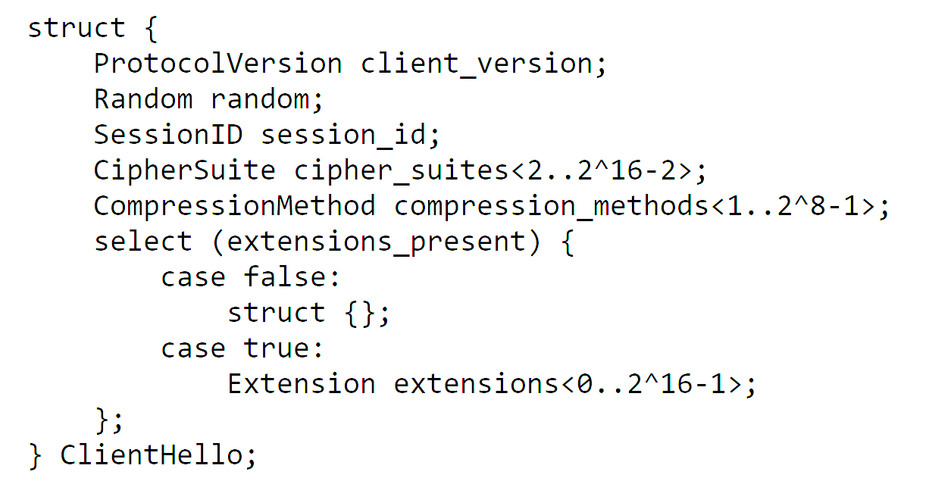
Client Hello
client_version: 0x303 for TLS 1.2
random: prevents “replay” attacks
cipher_suites: see next slide

Slide 26
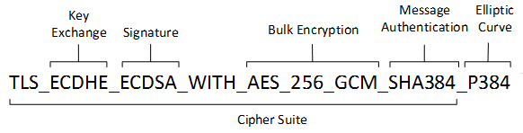
Cipher Suites
TLS_ECDHE_ECDSA_WITH_AES_128_GCM_SHA256
TLS_ECDHE_ECDSA_WITH_AES_256_GCM_SHA384
TLS_ECDHE_ECDSA_WITH_AES_128_CBC_SHA256
TLS_ECDHE_ECDSA_WITH_AES_256_CBC_SHA384
TLS_ECDHE_ECDSA_WITH_AES_128_CBC_SHA256
TLS_ECDHE_ECDSA_WITH_AES_256_CBC_SHA384
TLS_ECDHE_RSA_WITH_AES_128_GCM_SHA256
TLS_ECDHE_RSA_WITH_AES_256_GCM_SHA384
TLS_ECDHE_RSA_WITH_AES_128_CBC_SHA256
TLS_ECDHE_RSA_WITH_AES_256_CBC_SHA384
TLS_ECDHE_RSA_WITH_AES_128_CBC_SHA256
TLS_ECDHE_RSA_WITH_AES_256_CBC_SHA384
TLS_DHE_RSA_WITH_AES_128_GCM_SHA256
TLS_DHE_RSA_WITH_AES_256_GCM_SHA384
TLS_DHE_RSA_WITH_AES_128_CBC_SHA
… (there are MANY more!)

Slide 27
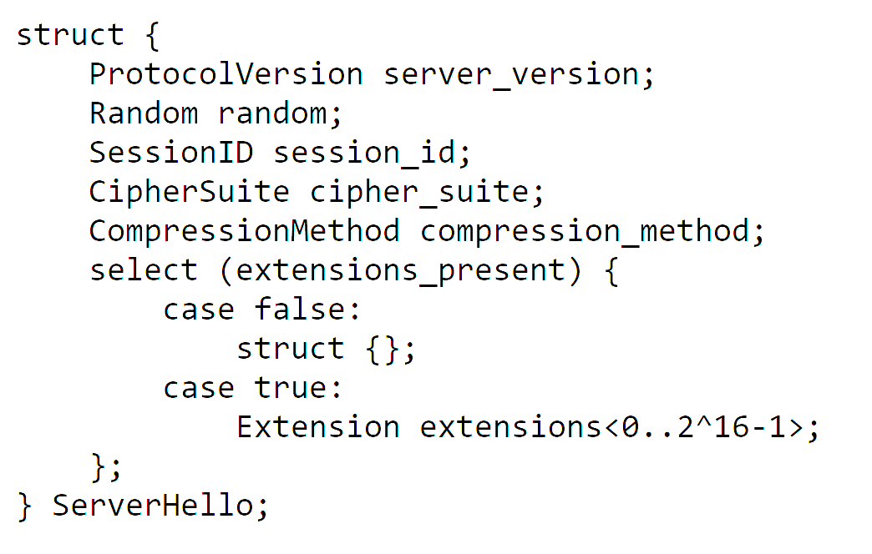
Server Hello
Note that the client offers a list of cipher suites and the server picks one

Slide 28
Certificate
We’ll talk about this more next time
Really needs its own lesson
Short Version:
Usually an X509 certificate
Identifies the server’s name (e.g., “www.amazon.com”)
Includes a public key such as an RSA public key
The public key must be compatible with the ciphersuite

Slide 29
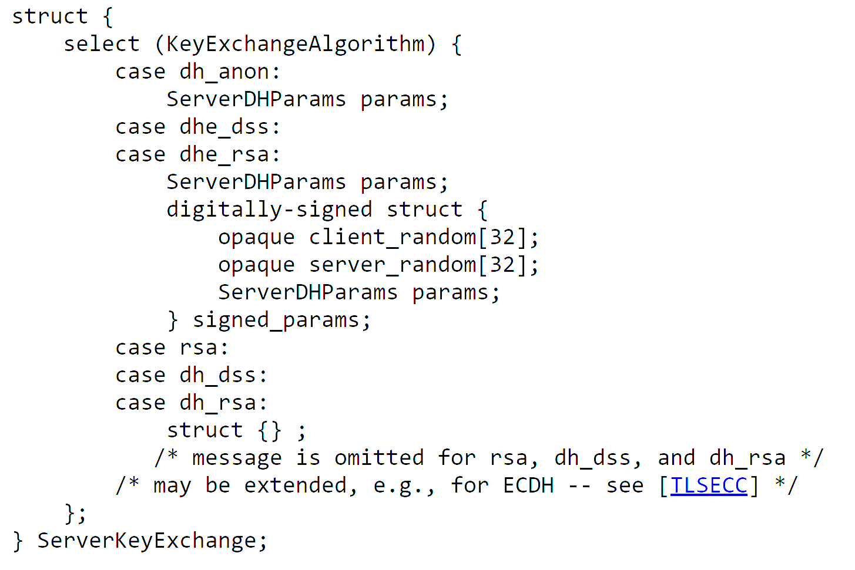
Server Key Exchange
If RSA key transport is used, this message is not sent
If DHE key agreement is used, this message sends the DHE public key
Notice the signature…

Slide 30
Server Hello Done
Server Hello Done carries no extra information
Marks the end of the Hello part

Slide 31
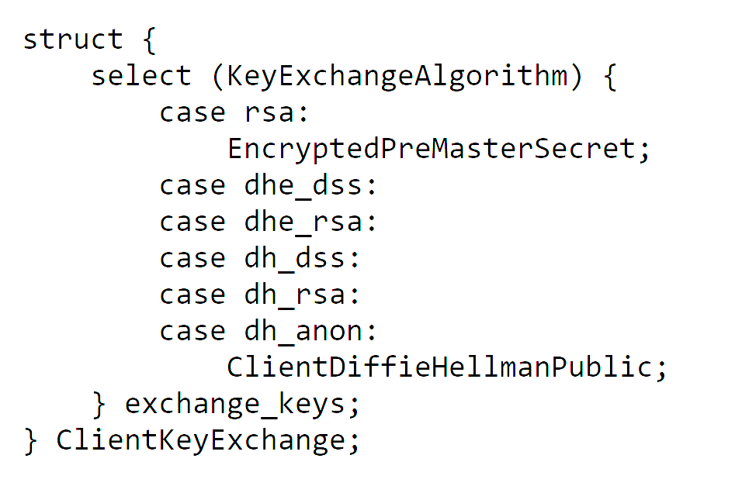
Client Key Exchange
If RSA key transport, sends a “pre master secret” encrypted under the server’s RSA public key from the server’s certificate
But, for DHE key agreement, sends DHE public key. “pre master secret” computed

Slide 32
Deriving Keys
For bi-directional communication, EACH SIDE needs its own keys
Step 1: Compute a master secret from a pre-master secret
Step 2: Compute a key expansion on the master secret
Step 3: Split up the key expansion block into the session keys

Slide 33
Generating the Key Block
DHE
PRF(pms, “master secret”,
client_random, server_random)
PRF(ms, “key expansion”,
server_random, client_random)
Pre-master Secret
Master Secret
Key Block

Slide 34
Splitting Key Block into Keys
Client Write Mac Key
Server Write Mac Key
Client Write Enc Key
Server Write Enc Key
Client IV
Server IV

Slide 35
Cipher Suites and Key Deriviaton
The side of each key depends on the algorithm
Some cipher suites don’t need IV’s; some don’t need MAC’s
PLEASE NOTE: a client WRITE key is a server READ key

Slide 36
Change Cipher Spec
Sent by the client after Client Key Exchange
Indicates that all future messages will be encrypted and MAC’d

Slide 37
Client Finished
Includes a hash of all handshake messages sent so far
Excludes Change Cipher Spec, which is not a handshake message
Excludes the current message (client finished)
Hash is computed as:
PRF(master_secret, “client finished”, Hash(handshake_messages))

Slide 38
Server Change Cipher Spec
Server verifies the client’s finished message
Remember, this message is AFTER change cipher spec, so encrypted
Server sends its own change cipher spec

Slide 39
Server Finished
Server sends its own encrypted Finished message
Hash of handshake messages includes client’s finished message
PRF(master_secret, “server finished”, Hash(handshake_messages))

